Slide 1

ITNSA
Network Security
TRI-Tech
Demitri Steyn
Regan Hunter
Stephen Bibbey

Slide 2
LEARNING OBJECTIVES
Understand the need for and importance of network security.
Explain methods of network security in Cisco Packet Tracer
Discuss the challenges of the network security.

Slide 3

VLANs
DHCP
CHALLENGES
Routing
Security

Slide 4
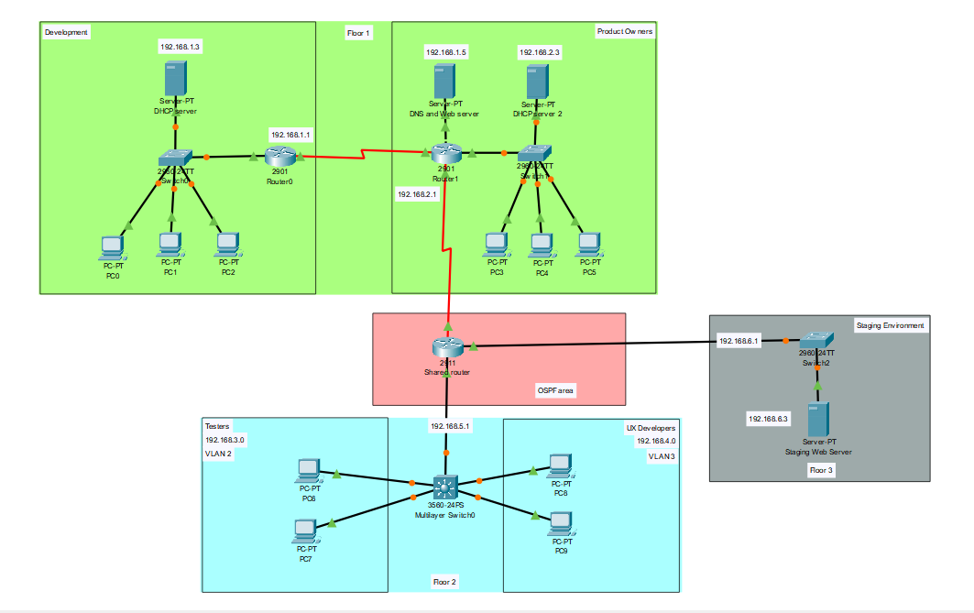
PREVIEW OF OUR PACKET TRACER

Slide 5
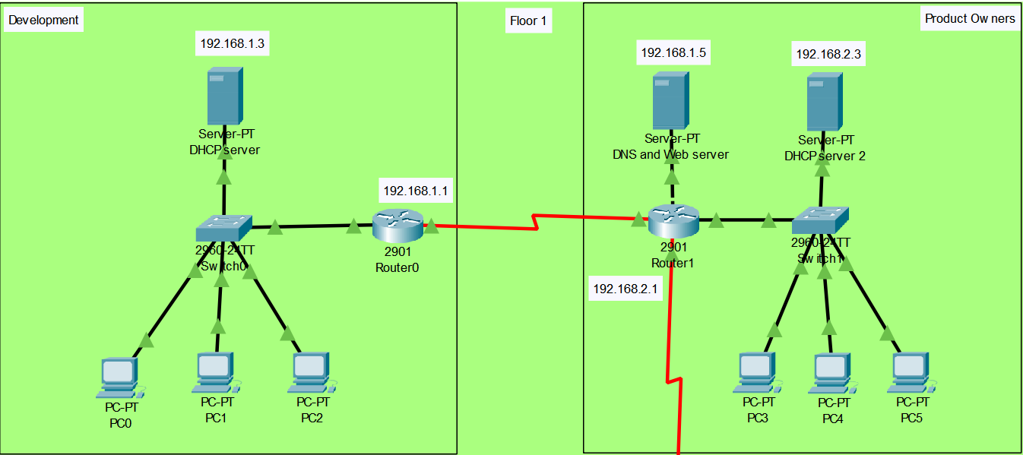
FLOOR 1

Slide 6
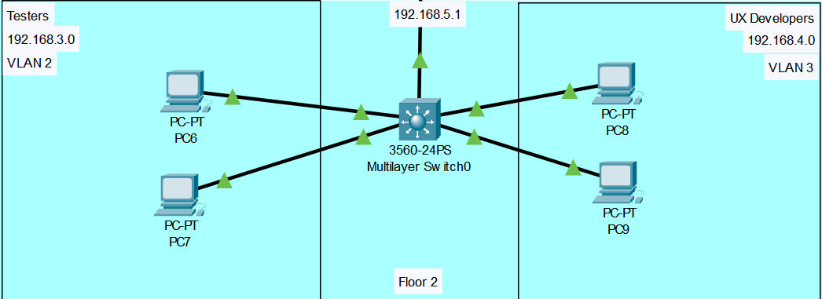
FLOOR 2

Slide 7
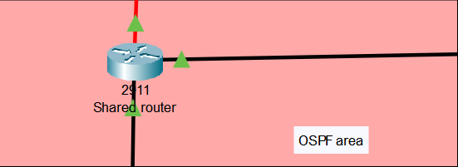
SHARED ROUTER (OSPF AREA)

Slide 8
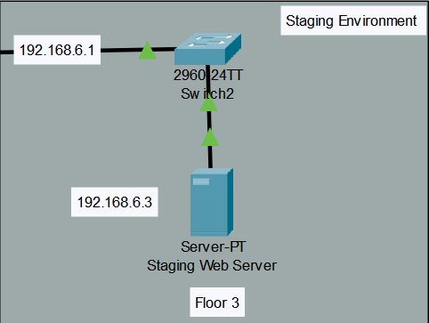
FLOOR 3 (STAGING ENVIROMENT)

Slide 9
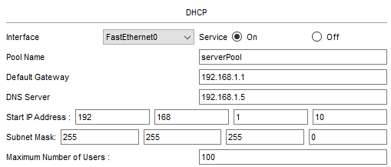
DHCP DEV CONFIGURATION

Slide 10
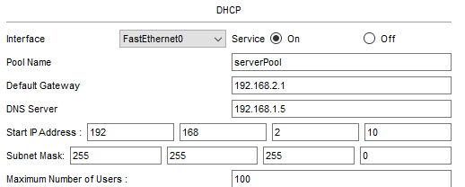
DHCP PRODUCT CONFIGURATION

Slide 11
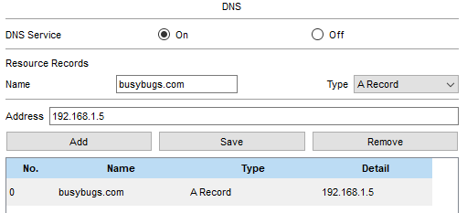
DNS SERVER CONFIGURATION

Slide 12
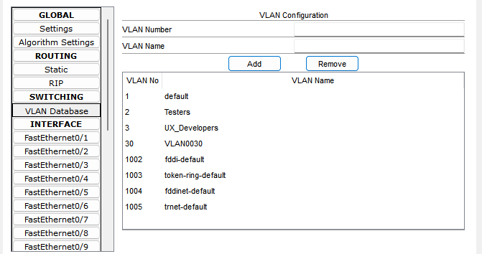
VLAN IMPLEMENTATION

Slide 13
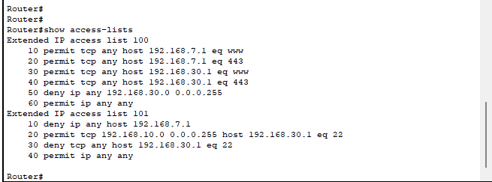
VLAN ACCESS CONTROL

Slide 14
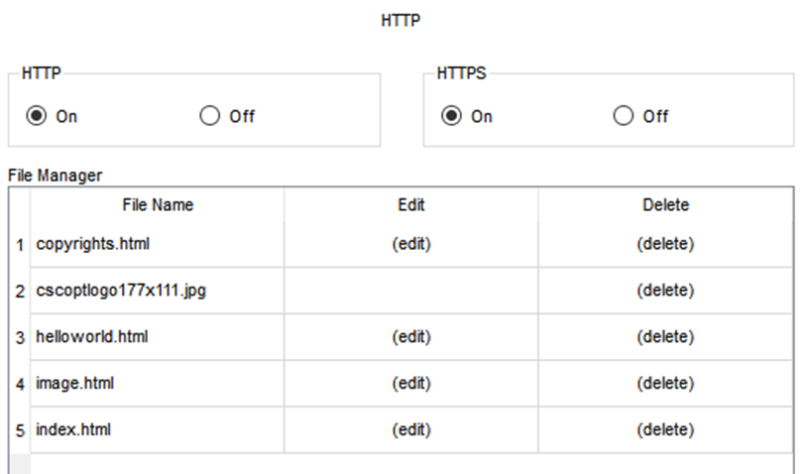
STAGING ENVIRONMENT CONFIGURATION

Slide 15
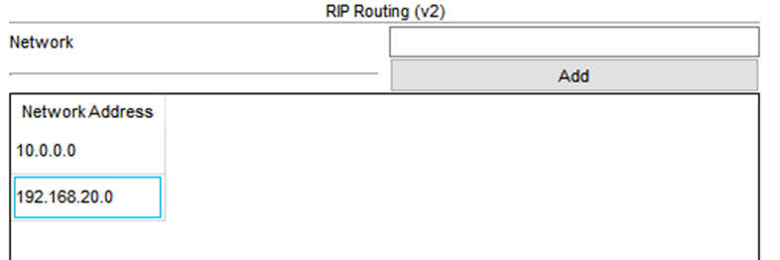
RIP

Slide 16
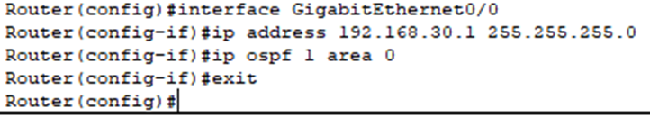
OSPF

Slide 17
Challenges of RIP & OSPF
RIP is slow, uses hop count, and doesn't scale well
Redistribution between RIP & OSPF requires careful implementation
OSPF is fast but more complex
Ensuring loop-free routing and prioritization

Slide 18
CONCLUSION
We all learned a lot about network security and packet tracer during this group project as well as working together as a team in creating a virtual network

Slide 19
Thank you

